Slide 1

Bubble Sort
-- #greenlearner --

Slide 2
Input/output
Input
Unsorted integer elements
Output
Sorted integer array
34 | 65 | 33 | 67 | 98
33 | 34 | 65 | 67 | 98

Slide 3
Steps/Algorithm
Start from the first element
Compare 1st and 2nd element
If 1st > 2nd – swap these elements
Else leave as it is
Move to next element and repeat 1st to 4th step
Repeat 1st to 5th step till 2nd last element

Slide 4
Dry run algorithm
34 | 65 | 33 | 67 | 98

Slide 5
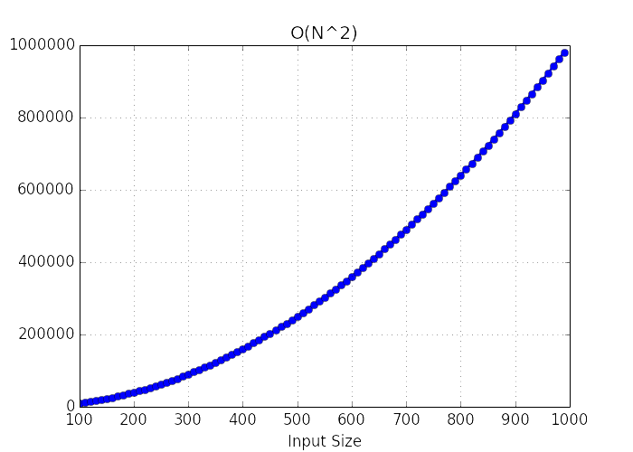
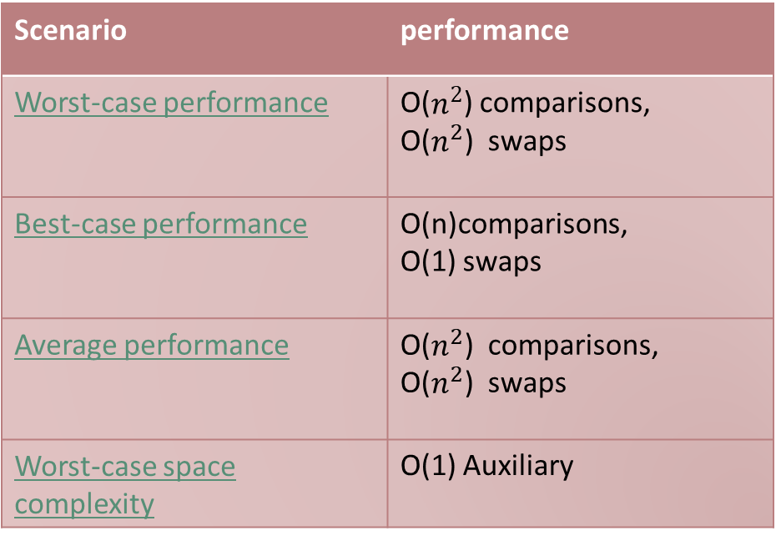
Performance
Scenario | performance
Worst-case performance | O($n^{2}$) comparisons, O($n^{2}$) swaps
Best-case performance | O(n)comparisons, O(1) swaps
Average performance | O($n^{2}$) comparisons, O($n^{2}$) swaps
Worst-case space complexity | O(1) Auxiliary

Slide 6
Where and when to use??
the algorithm is simple, it is too slow and impractical for most problems even when compared to insertion sort.
Bubble sort can be practical if the input is in mostly sorted order with some out-of-order elements nearly in position.

Slide 7
References
https://en.wikipedia.org/wiki/Bubble_sort

Slide 8
Next..
Insertion Sort..

